Slide 1


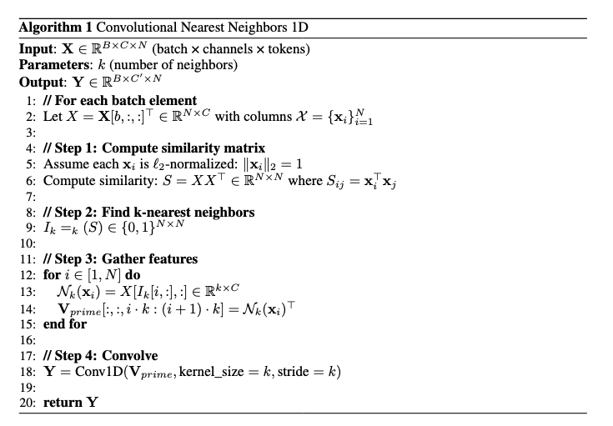
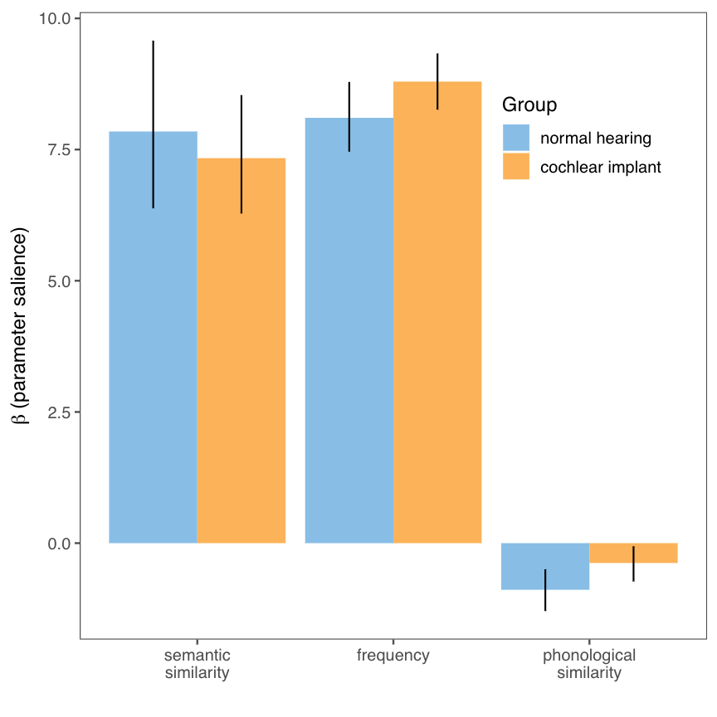
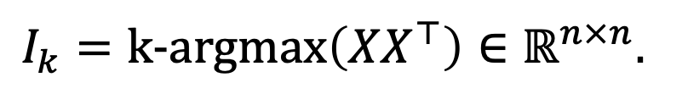
Convolutional Nearest Neighbors: Reinterpreting Convolution Through K-Nearest Neighbor Selection
Mingi Kang, Jeova Farias Sales Rocha Neto PhD.
Bowdoin College, ME
INTRODUCTION
EXPERIMENTAL RESULTS
Convolutional Nearest Neighbor (ConvNN) reinterprets convolution through k-nearest neighbor selection principle
Convolution’s neighbor selection is based purely on spatial distance between input features
(e.g a 3x3 convolution kernel selects k=9 nearest neighbors surrounding each feature including itself as a neighbor based on Euclidean distance in image coordinates
Neighbor selection can be based on Euclidean distance in image coordinates, feature-based similarity, or a combination of both.
ConvNN algorithm generalizes neighbor selection in convolutions beyond fixed spatial patterns though
1. Similarity Computation
2. K-Nearest Neighbor Selection
3. Weighted Aggregation
Structural models:
Embeddings with lower dimensions provided a better fit than models with higher dimensions.
The concatenated variants of speech2vec and word2vec performed better than the single-model or the “average” model.
For normal hearing group, the best-performing structural model emphasized word2vec over speech2vec (𝛼 = 0.4).
For cochlear implant group, the best-performing structural model emphasized speech2vec and word2vec equally (𝛼 = 0.5).
Process models:
Best-performing process model was the dynamic foraging model that incorporated semantic similarity, phonological similarity, and frequency in local “cluster” transitions and frequency in global “switch” transitions, and used the delta similarity method to assign cluster-switch designations.
BASE ALGORITHM
LEXICAL SOURCES / FLUENCY PERFORMANCE
$$I_{k}=k\text{-}argmax\left(XX^{⊤}\right)∈ℝ^{n×n}.$$
GENERALIZATIONS
CIs attend more to frequency than NHs, no differences in use of semantic similarity
Both groups appear to use phonology for local within-cluster transitions (based on best-performing models)
DISCUSSION
CIs and NHs WERE SENSITIVE TO REPRESENTATIONS DERIVED FROM TEXT AND SPEECH
The lexicon is most likely represented in a multimodal format across both groups.
CIs EQUALLY EMPHASIZED REPRESENTATIONS DERIVED FROM SPEECH & TEXT, NHs DE-EMPHASIZED SPEECH IN FAVOR OF TEXT
Among neurotypical individuals, speech-related cues may be overtaken by textual or linguistic cues over time, whereas CIs may rely on these cues a lot more than their peers.
REFERENCES
REFERENCES

